Slide 1



Company
Profile
CONSULTING & TRAINING
SERVICES
PT DINAMIS TRACONS
Metro Trade Center Kav. B36
Jl. Soekarno Hatta 590 Bandung 40286
Phone: (022) 753 6433, Fax: (022) 753 7560
Email: traconsdinamis@gmail.com

Slide 2

Who we are
Dinamis Consulting is a leading business process improvement and management consulting firm, helping organizations to be significantly more efficient, effective and financially profitable.
We provide best practices business optimization solutions to implement address process, technology & organizational improvements.
Dinamis Consulting facilitates, enhanced competitiveness through multi-faceted interventions leading to Business Improvement through consulting, people, process and operational assessments, benchmarking and resource provisioning through Quality Outsourcing.
We carefully select our consultants in order to offer our customers foremost quality of expertise together with extensive experience of industry practices. Our consultants have substantial track record of executing major consulting assignments involving organization wide deployment, multi geography, and on the advisory mode for continuous process improvement.

Slide 3

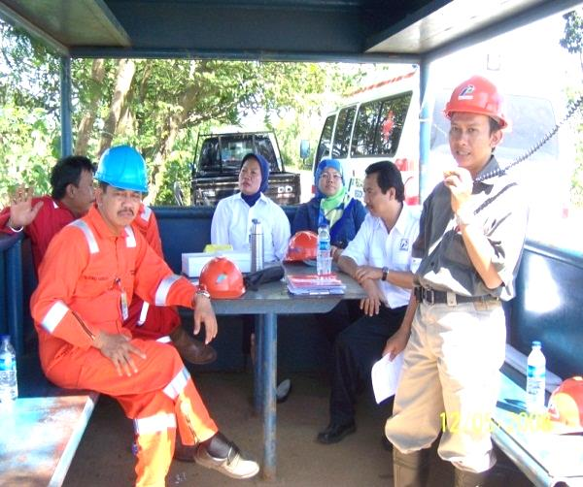
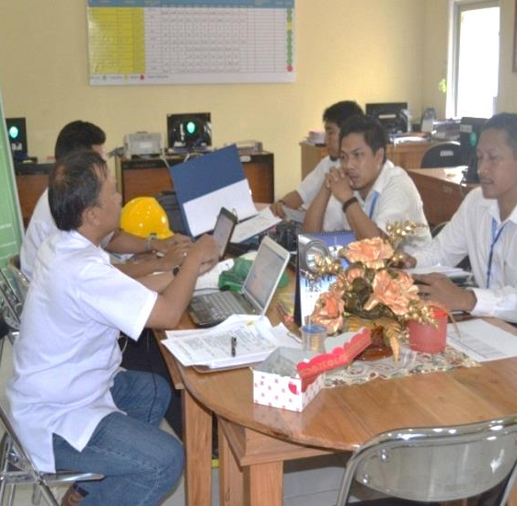
Our Services
TRAINING
Focused on Business Optimizations and Improvement Principles
CONSULTING, SURVEYS, CERTIFICATION
Focused on helping Organizations towards their journey of deploying Best Practices for Business Excellence
AUDITING
Focused on helping Organizations towards improvement gap according to standards and regulation

Slide 4
Training & Certification Offerings
ISO Management Systems
ISO 9001 – Quality Management System
ISO 14001 – Environment Management System
ISO 50001 – Energy Management System
ISO 22000 – Food Safety Management System
ISO 17025 – Laboratory Management System
ISO 22301 – Business Continuity Management System
ISO 31000 – Enterprise Risk Management System
ISO 20000 – IT Service Management
ISO 37001 – Anti Bribery Management System
ISO 27001 – Information Security Management System
ISO 28000 – Supply Chain Security Management System
ISO 37301 – Compiance Management System
ISO 45001 – Safety and Health Management System
ISO 15489 – Records Management
HSSE-Health, Safety. Security & Environment
Safety and Health Management System based on OSA
Sistem Manajemen Keselamatan & Kesehatan Kerja PP No. 50 Tahun 2012
Sistem Manajemen Pengamanan Perpolri No. 07 / 2019
Job Safety Analysis
Hazard Identification Risk Assessment and Determined Risk Control
First Aid
Defensive Driving Courses
HAZOP-HAZID
Safety Officer Course
Evacuation Symbol and Map Provision
Industrial Hygiene
Safety and Risk Management assessment
Vendor QHE Audit
Behavior based safety
CSMS
Emergency Exercise
FRA
Safety Leadership
Process Safety management

Slide 5
Training & Certification Offerings
Human Resources Management
Achievement Motivation Training
Staffing administration
Job Analysis and Performance Evaluation
Housekeeping Management 5R/ 5S
Collaboration Management
Community Development
Corporate Social Responsibility (CSR)
Managing Work Process and Performance
Training management
Performance Management
Stress Management
Human Resources Management
HRD Audit
Salary and Benefits Administration
Team – Based Organization Program
Training Needs Analysis
CBT/CBA - Competence Based Training / Competence Based Assessment
Personal / Equipment Certification / Testing
Lifting Equipment Certification / Riksa uji Alat Angkat Angkut (ex. forklift , backhoe , loaders , excavators, crane, etc.)
Pressure Vessel Certification / Riksa uji Pesawat uap dan Bejana Tekan
Electricity Tools & Instalation Certification / Riksa uji peralatan dan Instalasi Listrik
Fire Fighting Instalation Certification / Instalasi Alat Pemadam Kebakaran (Intalasi Hydrant dan peralatan pendukungnya)

Slide 6

Training Approach
Assess industry development & identify new course
Prepare course material & delivery through multiple channels
Continously audit & upgrade existing courses
Identify & Analyze customer needs
Design solutions aligned to industry standards
Host workshops
Evaluation of candidates
Obtain feedback & customer satisfaction score, provide inputs in solution development program
CONTENT CREATION
SOLUTION DEVELOPMENT
DELIVERY
Benefits of Workforce Development through Training & Certification
Certification for Career Progression
Increased Productivity & Performance of the Workforce
Focused Training Spends
Improved Credibility with Clients & Partners
Benchmark for Hiring & Promotion
Build Organization Quality Culture
Attrition Control and Retention

Slide 7

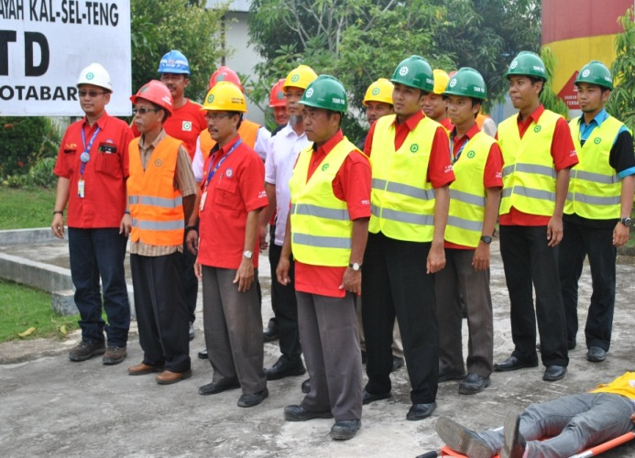
Consulting
Services
Consulting Approach
Our approach use R2P Method:
REFORM REVOLUTIONIZE PERFORMANCE
Restructuring,
Re-Engineering and
Project Management
We focus to enhance best solution performance to our clients
Dinamis Consulting is a trusted consulting partner to organizations of all sizes from small to start-ups to large.
Dinamis Consulting works with organizations across various industries, for enterprise-wide deployment of process improvement and quality initiatives using various models like ISO Management System, Project Management, Risk Management, HSE, etc.
Dinamis Consulting has designed its offerings, to help organizations align their strategic objectives with day-to-day business and operational goals. Our services aid companies to reduce cycle time, increase productivity and improve quality of service delivery and processes.

Slide 8
What we do
Audit, Survey & Implement QMS ISO 9001, OHS MS (OHSAS 18001 / PP No. 50 tahun 2012 / ISO 45001), EMS ISO 14001, Security Management System (Perkapolri 24-2007 / Perpol 7-2019), ABMS ISO 37001, ISMS ISO 27001, Quality Improvements for:
Construction
PT Seneca Indonesia; PT Angkasapuri Konsursindo; PT Arwana Nuansa Keramik, etc.
Pertamina EP Region Jawa; Pertamina Gas Eastern Java Area; Pertamina Gas Western Java Area; Pertamina Gas Northern Sumatera Area; Pertamina Gas Kalimantan Area; BP Tangguh, etc.
Oil & Gas
PT Indonesia Power PLTP UBP Kamojang (Kamojang, Darajat, Salak); PT PLN Sektor Pembangkitan Sumbagsel; PT PLN Sektor Barito; PT PLN - PLTU Naganraya; PT PLN Tarakan; UIP Banjarbaru; UIP Pontianak
Power Plant
PT Hanshin Indonesia; PT Katolec Indonesia; PT Bookwang; PT FUCHS Indonesia; PT Memorytech Indonesia; PT LG Indonesia; PT Semen Padang; PT Semen Gresik, etc.
Manufacturing
Bappeda Cimahi; BKD Cimahi; Dinas Kesehatan DKI Jakarta; Pusat Pemeriksaan Kesehatan Pegawai Pemprov DKI Jakarta; Badan Kepegawaian Negara, Puskesmas Senen, PT Perusahaan Pengelola Aset (PPA), etc.
Government
Indonesian Embassy in Singapore; Indonesian Embassy in Kualalumpur; Indonesian Embassy in Bangkok; Indonesian Embassy in Hong Kong; Indonesian Embassy in Copenhagen, etc.
Overseas

Slide 9
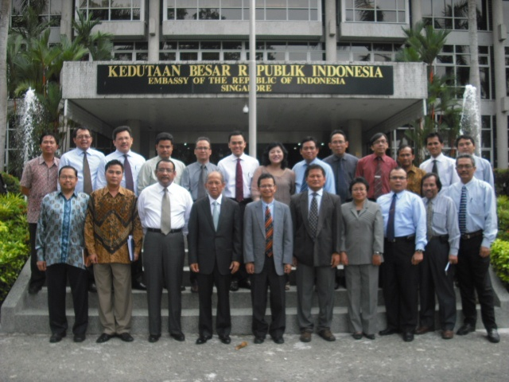
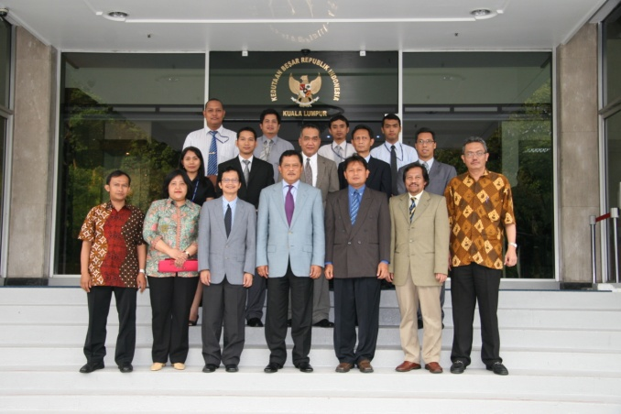
Consulting program
Restructuring
Financial Advisory
Reengineering
Market Strategy
Human Resources
Product Development & Formulation (Foods)
Process & Business Planning
Inventory & Logistic
Market Design & Analysis
Market & Policy Research
Innovation Strategy
ISO & Product Certification Preparation (ISO 9001, ISO 14001, ISO 37001, ISO 27001, ISO 37301, ISO 17025)
Safety Management (ISO 45001 & SMK3/PP 50 - 2012)
Security Management System (Perpolri No. 07/2019)
ISRS 8th
Enterpreneurship
Industrial & Business Cases
Risk Management

Slide 10
Contact Us:
PT DINAMIS TRACONS
Metro Trade Center Kav. B36
Jl. Soekarno Hatta 590 Bandung 40286
Phone: (022) 753 6433, Fax: (022) 753 7560
Email: traconsdinamis@gmail.com

